Slide 1
Organ Systems

Slide 2
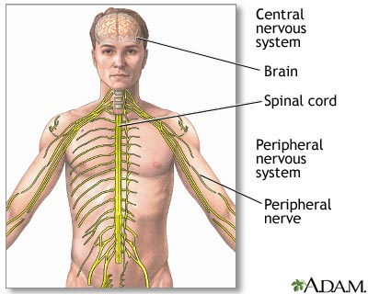
Nervous
Function: To transmit signals from brain to body and your body to brain
Organs:
Brain
Spinal Cord
Nerves

Slide 3
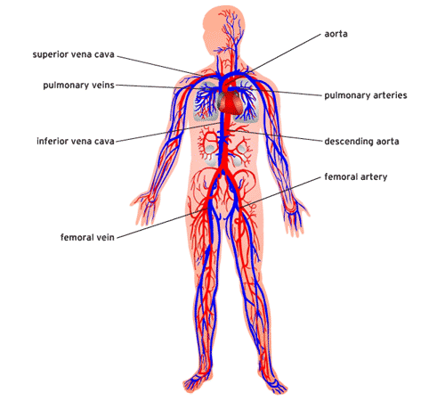
Circulatory
Function: To transport food, water, nutrients, waste throughout the body
(The heart DOES NOT make blood, it just pumps it)
Organs:
HEART
VEINS
ARTERIES
CAPILLARIES

Slide 4
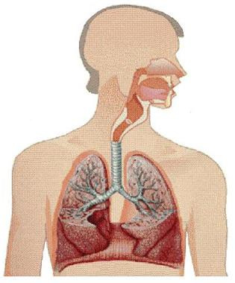
Respiratory System
Function: To take in oxygen and let out carbon dioxide (CO2)
Organs:
Mouth and Nose
Trachea
Lungs
Diaphragm

Slide 5
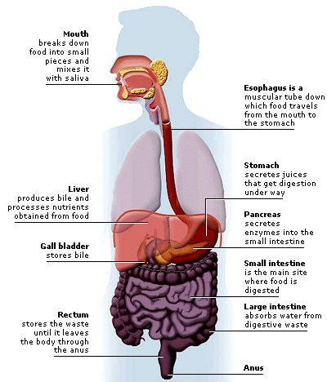
Digestive
Function: To break down food for cells to have energy. Get rid of waste.
Organs:
Mouth
Esophagus
Stomach
Small Intestine
Liver
Large Intestine/Colon
Rectum
Anus

Slide 6
Skeletal
Function: To support body, protect organs, make blood in bones
Organs:
206 Bones

Slide 7
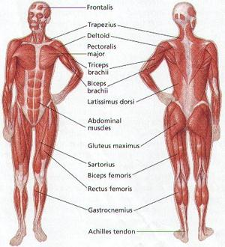
Muscular System
Function: To move body, help breathe, move food
Organs:
All Muscles

Slide 8
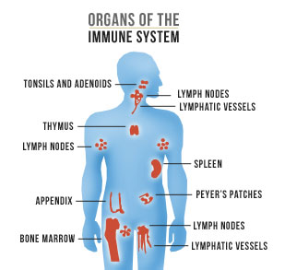
Immune System
Function: To fight infections and illness. To heal injuries.
Organs:
Thymus
Spleen
Lymph nodes
Tonsils

Slide 9
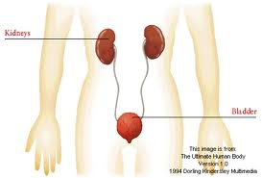
Excretory (Urinary) System
Function: To filter the blood and get rid of liquid waste
Organs:
Kidneys
Bladder

